Slide 1

Note: The data and information in this document is reflective of a hypothetical situation and client. This document is to be used for KPMG Virtual Internship purposes only.
Sprocket Central Pty Ltd
Data analytics approach
[Division Name] - [Engagement Manager], [Senior Consultant], [Junior Consultant]

Slide 2
Note: The data and information in this document is reflective of a hypothetical situation and client. This document is to be used for KPMG Virtual Internship purposes only.
Agenda
Introduction
Data Exploration
Model Development
Interpretation

Slide 3
Note: The data and information in this document is reflective of a hypothetical situation and client. This document is to be used for KPMG Virtual Internship purposes only.
Introduction
Customer Analytics for Sprocket Central Pty Ltd
As a part of the marketing strategy, we’ve analyzed existing and new customer datasets to identify which new customers to target based on these Features.
Age (class) distribution.
Distribution of customers by job industry
Customer's Wealth segment
Distribution of gender by state
Note: Plots shown in upcoming slides will be placed accordingly above plot is the current customers and the below one is new customers.

Slide 4
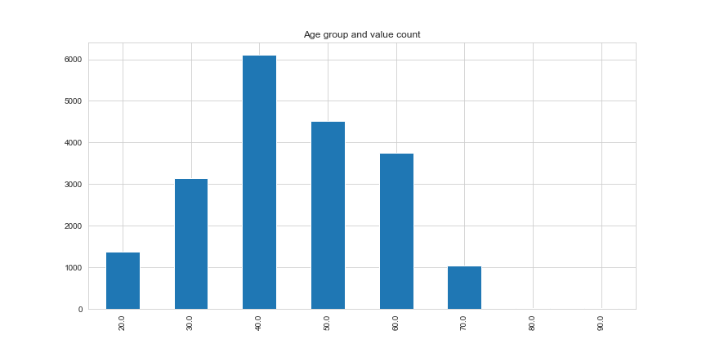
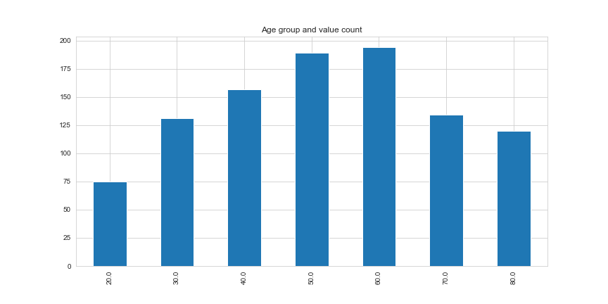
Note: The data and information in this document is reflective of a hypothetical situation and client. This document is to be used for KPMG Virtual Internship purposes only.
Data Exploration
Age (class) distribution.
As from the above bar chart we can see there are less than 1000 data points for the age group of 80 and 90.
There are more transactions of customers of the age group between 40 – 50.
There are much more new customers in the age group of 60-70 years old and above compared to the original customer groups.

Slide 5
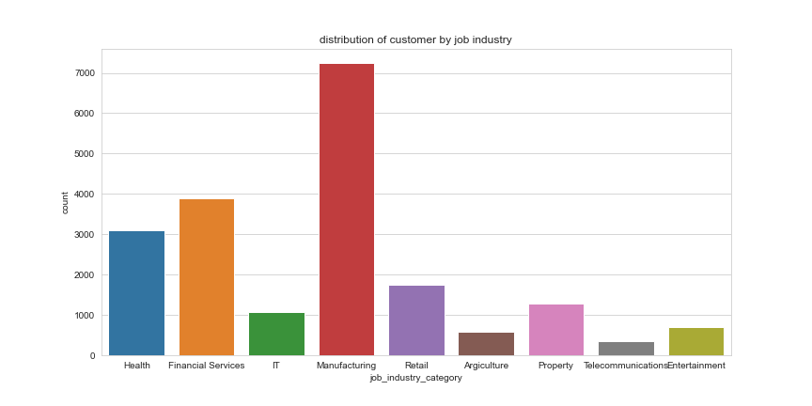
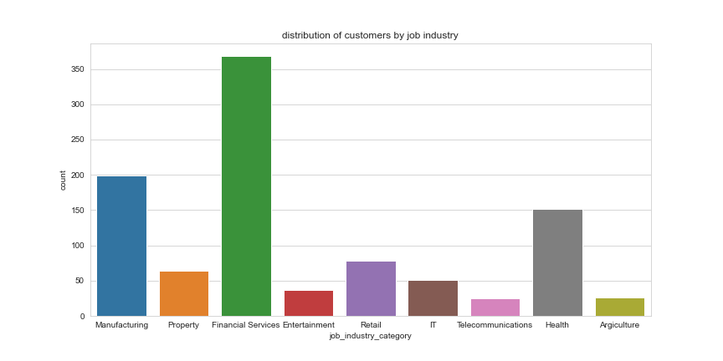
Note: The data and information in this document is reflective of a hypothetical situation and client. This document is to be used for KPMG Virtual Internship purposes only.
Model Development
Distribution of customers
by job industry
Majority of the current customers work in the manufacturing industry followed by the financial services and health industry.
When it comes to new customers financial services is the leading job industry, and manufacturing comes second then health.
So, the target customers are the ones who work in these three industries.

Slide 6
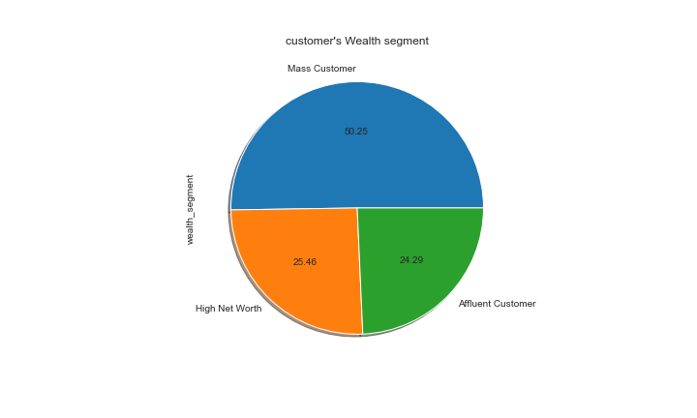

Note: The data and information in this document is reflective of a hypothetical situation and client. This document is to be used for KPMG Virtual Internship purposes only.
Interpretation
Customer's Wealth segment
In the present customers around 50% of the data in the wealth segment belongs to mass customers.
The new customers’ wealth segment is also split in a similar manner.

Slide 7
Note: The data and information in this document is reflective of a hypothetical situation and client. This document is to be used for KPMG Virtual Internship purposes only.
Appendix

Slide 8
Note: The data and information in this document is reflective of a hypothetical situation and client. This document is to be used for KPMG Virtual Internship purposes only.
Appendix

